Slide 1
Sequential Medical Decision-Making with RL August 2, 2019
MMCi Applied Data Science
Block 5, Lecture 2
Matthew Engelhard
Notes:
NEED INFO ABOUT ROC, CONFUSION MATRIX, ETC HERE

Slide 2
Two Illustrative Examples
Sepsis Management and Artificial Pancreas

Slide 3
Sequential Medical Decision-Making
An agent
takes actions
based on the state of a system
to maximize reward
Notes:
examples: robot navigating
Computer program playing video game
Doctor deciding on treatment(s)
Two things to note:
- this is happening on an ongoing basis
- Reward must be quantified numerically

Slide 4
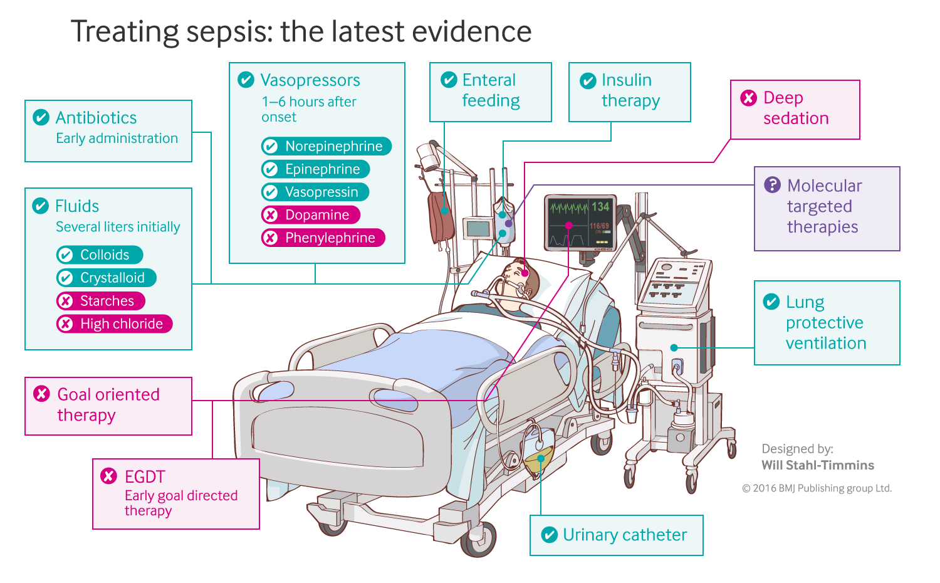
“Uncertainties still exist regarding the optimal type of fluid, the optimal volume, and the best way to monitor the response to therapy.”
Gotts JE, Matthay MA. Sepsis: pathophysiology and clinical management. bmj. 2016 May 23;353(i1585).
Notes:
SOFA: sequential organ failure assessment
Traditional Approach:
central venous pressure (8-12 mm Hg)
mean arterial pressure (65-90 mm Hg)
urine output (0.5 mL/kg/h)
EGDT added:
central venous oxygen saturation (70% target in early goal directed therapy)

Slide 5
Sequential Medical Decision-Making:
Sepsis Management
An agent
takes actions
based on the state of a system
to maximize reward
A clinician
gives fluid and/or vasopressor
based on the patient’s physiologic status
to maximize chance of survival
Notes:
Note that this is happening on an ongoing basis

Slide 6
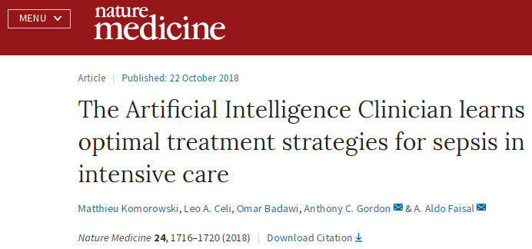
Deep Reinforcement Learning for Sepsis Treatment
Raghu A, Komorowski M, Ahmed I, Celi L, Szolovits P, Ghassemi M.
arXiv:1711.09602. 2017 Nov 27
Policy via Deep Q-Learning
17,898 patients from MIMIC-III
Independent validation on the Philips eICU Research Institute Database:
>3.3 million admissions from 2003–2016 in 459 ICUs across the US
Notes:
The Medical Information Mart for Intensive Care version III (MIMIC-III)
5 min in

Slide 7
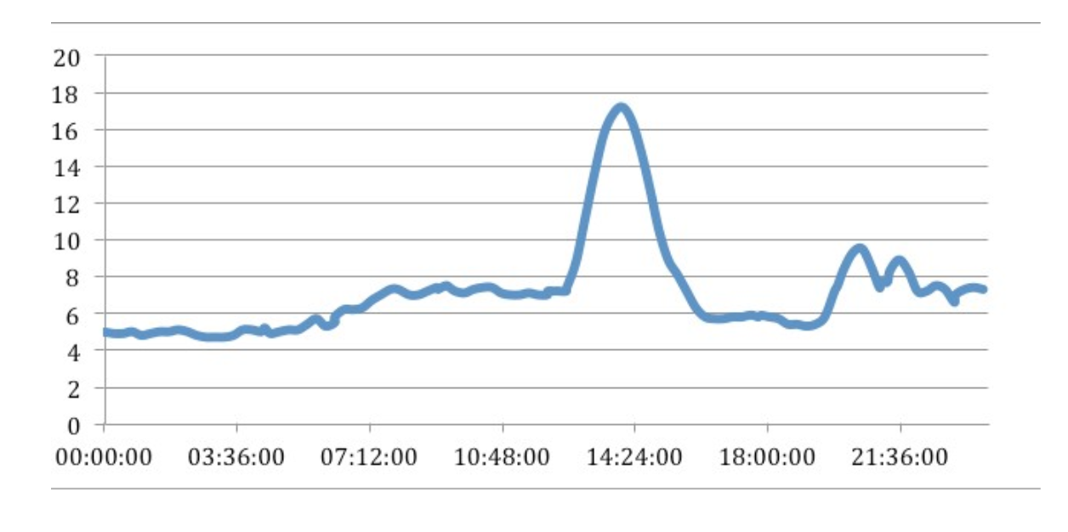
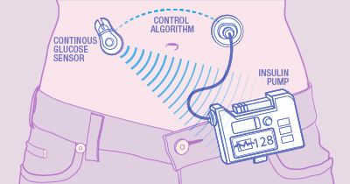
Closed-Loop Blood Glucose Control (artificial pancreas)
Blood Glucose Readings from Continuous Glucose Monitor
mmol/L
https://medium.com/@justin_d_lawler/continuous-glucose-monitoring-the-first-four-weeks-7a6aa5fdb06e

Slide 8
https://www.mayo.edu/research/labs/artificial-pancreas/overview
Sequential Medical Decision-Making:
Artificial Pancreas
An agent
takes actions
based on the state of a system
to maximize reward
A computer program
administers insulin
based on blood glucose and recent patient behaviors
to maintain normoglycemia
Notes:
Note that this is happening on an ongoing basis

Slide 9
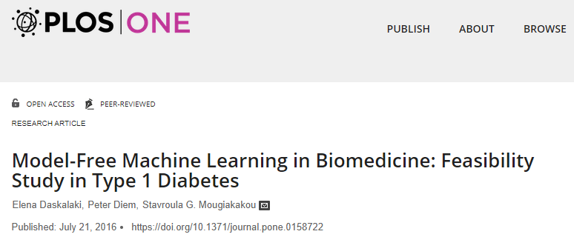

Slide 10
Formulating the RL Problem

Slide 11
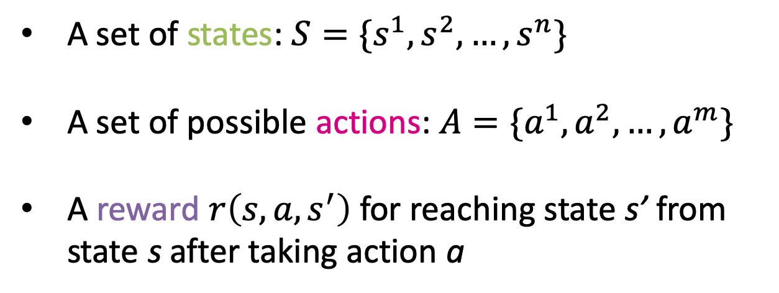
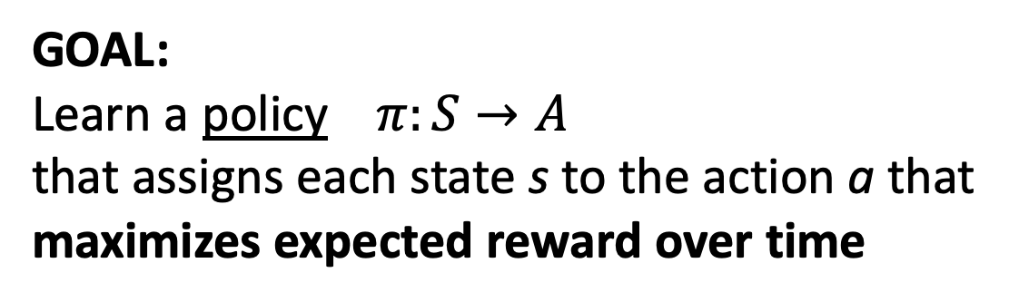
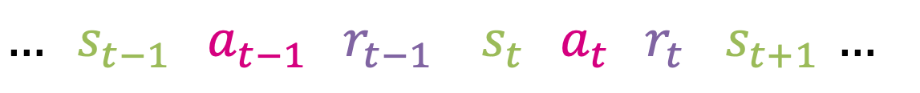
The RL Paradigm
A set of states: $S=\{s^{1},s^{2},…,s^{n}\}$
A set of possible actions: $A=\{a^{1},a^{2},…,a^{m}\}$
A reward $r\left(s,a,s^{′}\right)$ for reaching state s’ from state s after taking action a
GOAL:
Learn a policy $π:S→A$
that assigns each state s to the action a that
maximizes expected reward over time
$… s_{t−1} a_{t−1} r_{t−1} { s}_{t} a_{t} r_{t} { s}_{t+1} …$
Notes:
The state is usually represented as a vector, e.g. of physiologic measurements
reward can include costs – might be negative
There is (in general) randomness in these transitions… a given action may not always produce the same result
Model may not be known

Slide 12
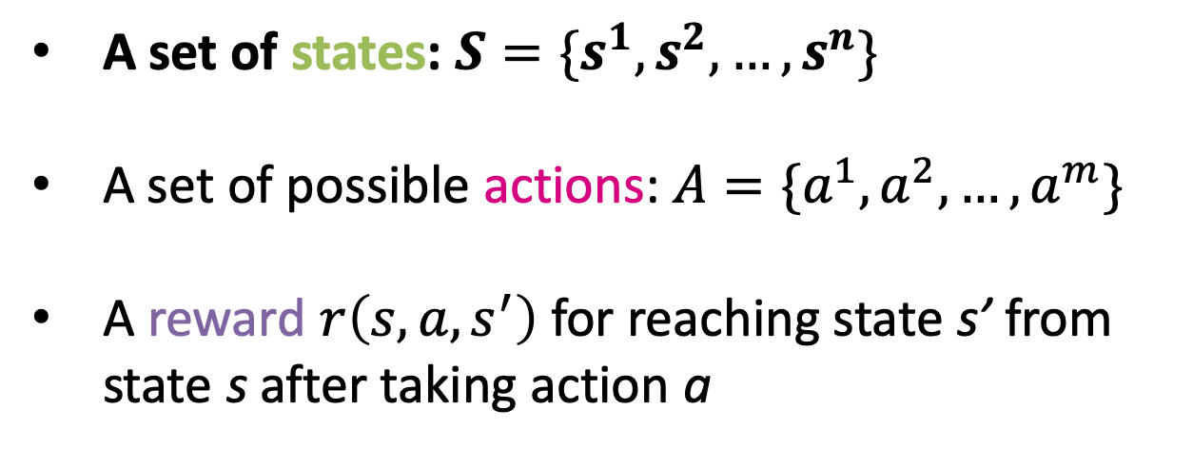
The RL Paradigm
A set of states: $S=\{s^{1},s^{2},…,s^{n}\}$
A set of possible actions: $A=\{a^{1},a^{2},…,a^{m}\}$
A reward $r\left(s,a,s^{′}\right)$ for reaching state s’ from state s after taking action a
GOAL:
Learn a policy $π:S→A$
that assigns each state s to the action a that
maximizes expected reward over time
$… s_{t−1} a_{t−1} r_{t−1} { s}_{t} a_{t} r_{t} { s}_{t+1} …$
Notes:
The state is usually represented as a vector, e.g. of physiologic measurements
reward can include costs – might be negative
There is (in general) randomness in these transitions… a given action may not always produce the same result
Model may not be known

Slide 13
Chess or Go: the state is what you see on the board
Notes:
Very clear how to define the state.
Clear set of information that is relevant to decision-making, and we’re able to observe all of it
Less so in medicine
Moreover, what’s on the board right now is the only thing that matters
Doesn’t matter how we got here – has no impact on the best decision going forward
Not always the case in medicine
So there are these two related questions.
What information is important to my decision-making?
What information do I have access to?

Slide 14

State $st$: Artificial Pancreas
Blood Glucose Readings from Continuous Glucose Monitor
Idea 1:
The state is the current blood glucose value
mmol/L
https://medium.com/@justin_d_lawler/continuous-glucose-monitoring-the-first-four-weeks-7a6aa5fdb06e
Notes:
Mention unobserved variables here

Slide 15
State $st$: Artificial Pancreas
Blood Glucose Readings from Continuous Glucose Monitor
Idea 2:
The state is the current blood glucose value plus recent trends
mmol/L
https://medium.com/@justin_d_lawler/continuous-glucose-monitoring-the-first-four-weeks-7a6aa5fdb06e
Notes:
Mention unobserved variables here

Slide 16
State $st$: Artificial Pancreas
Blood Glucose Readings from Continuous Glucose Monitor
Idea 3:
The state is the current blood glucose value, recent trends, and the patient’s insulin sensitivity
mmol/L
https://medium.com/@justin_d_lawler/continuous-glucose-monitoring-the-first-four-weeks-7a6aa5fdb06e
Notes:
Mention unobserved variables here

Slide 17
State $st$: Artificial Pancreas
Blood Glucose Readings from Continuous Glucose Monitor
The state: all information relevant to our decision
BG trends
Previous insulin doses
Patient physiology
Recent behaviors (e.g. eating, physical activity)
mmol/L
https://medium.com/@justin_d_lawler/continuous-glucose-monitoring-the-first-four-weeks-7a6aa5fdb06e
Notes:
Mention unobserved variables here

Slide 18

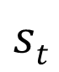
State $st$: Sepsis
Category | Items | Type
Demographics | Age | Continuous
 | Gender | Binary
 | Weight | Continuous
 | Readmission to intensive care | Binary
 | Elixhauser score (premorbid status) | Continuous
Vital signs | Modified SOFA* | Continuous
 | SIRS | Continuous
 | Glasgow coma scale | Continuous
 | Heart rate, systolic, mean and diastolic blood pressure, shock index | Continuous
 | Respiratory rate, SpO2 | Continuous
 | Temperature | Continuous
Lab values | Potassium, sodium, chloride | Continuous
 | Glucose, BUN, creatinine | Continuous
 | Magnesium, calcium, ionized calcium, | Continuous
 | carbon dioxide | Continuous
 | SGOT, SGPT, total bilirubin, albumin | Continuous
 | Hemoglobin | Continuous
 | White blood cells count, platelets count, PTT, PT, INR, pH, Pa02, PaCO2, base excess, bicarbonate, lactate, PaO2/FiO2 ratio | Continuous
Ventilation parameters | Mechanical ventilation | Binary
 | FiO2 | Continuous
Medications and fluid balance | Current IV fluid intake over 4h | Continuous
 | Maximum dose of vasopressor over 4h | Continuous
 | Urine output over 4h | Continuous
 | Cumulated fluid balance since admission (includes preadmission data when available) | Continuous
Age
Static features
Time-varying features
Fi0₂
$$st$$
Notes:
Aggregate in 4-hour windows – not going to worry about history prior to that moment.
In other words, they say: these are the pieces on the board; this is all we need to know.
But keep in mind that they do have information like demographics & medications

Slide 19
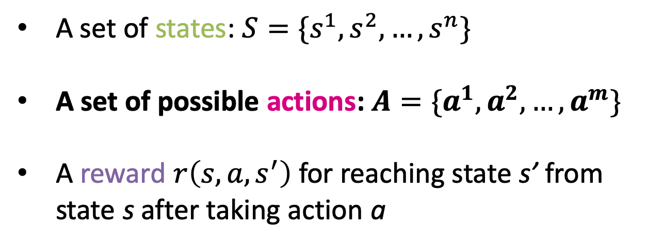
The RL Paradigm
A set of states: $S=\{s^{1},s^{2},…,s^{n}\}$
A set of possible actions: $A=\{a^{1},a^{2},…,a^{m}\}$
A reward $r\left(s,a,s^{′}\right)$ for reaching state s’ from state s after taking action a
GOAL:
Learn a policy $π:S→A$
that assigns each state s to the action a that
maximizes expected reward over time
$… s_{t−1} a_{t−1} r_{t−1} { s}_{t} a_{t} r_{t} { s}_{t+1} …$
Notes:
Wrap-up on the state
Note that here, we’re talking about a finite number of states
In vanilla Q Learning, we do need finite number
With deep Q learning, we have greater flexibility
Moving on to actions.

Slide 20
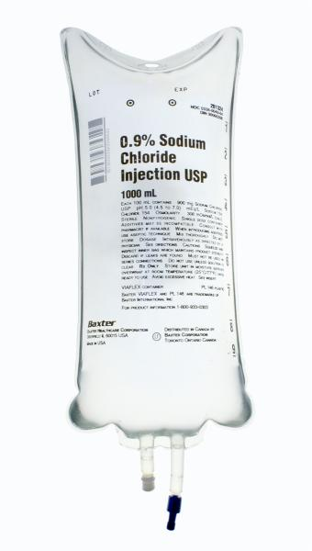
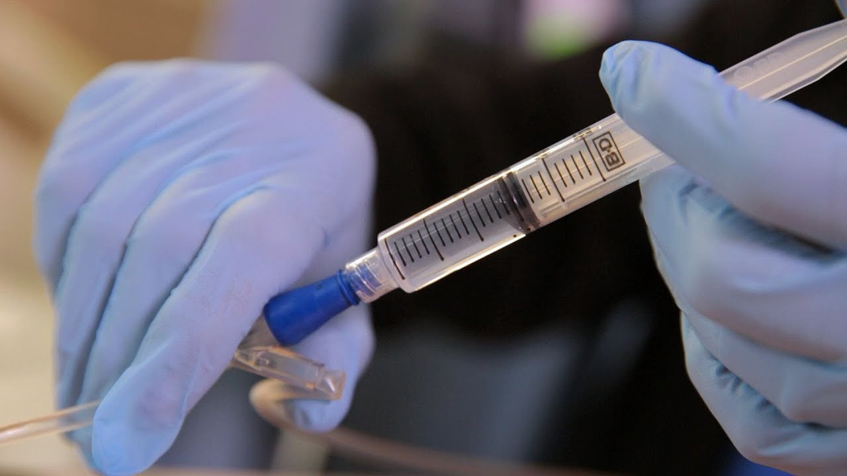

Actions $at$: Sepsis Management
How much fluid?
Vasopressor dose?
Notes:
The point here – LOTS of choices here
(not a small set)

Slide 21
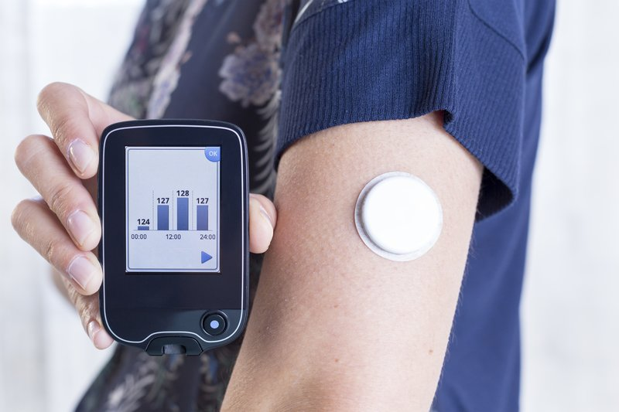

Actions $at$ : Artificial Pancreas
Insulin Basal Rate
×
Insulin Bolus Amount
https://time.com/4703099/continuous-glucose-monitor-blood-sugar-diabetes/

Slide 22
Actions $at$ : Artificial Pancreas
Insulin Basal Rate
×
Insulin Bolus Amount
×
Glucagon Bolus Amount
Must be discretized
https://time.com/4703099/continuous-glucose-monitor-blood-sugar-diabetes/

Slide 23
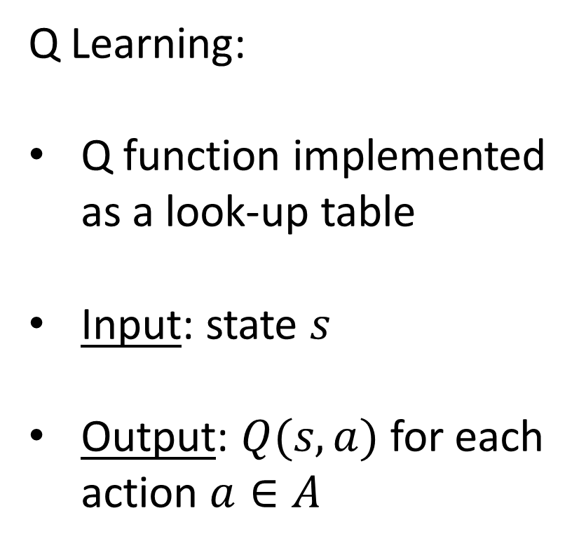
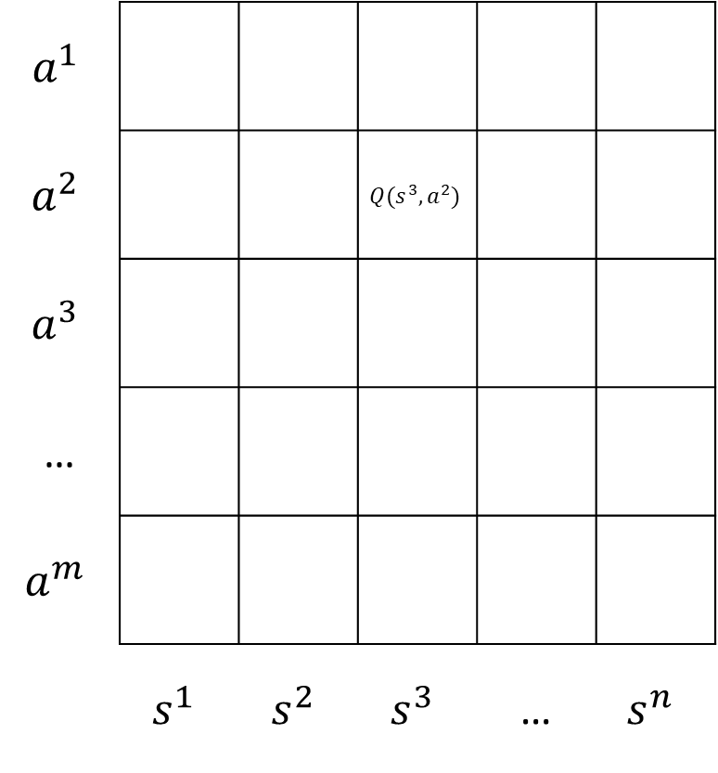
We need a finite set of actions to choose from
$$a^{1}$$
$$a^{2}$$ |  |  | $$Q(s^{3},a^{2})$$
$$a^{3}$$
…
$$a^{m}$$
 | $$s^{1}$$ | $$s^{2}$$ | $$s^{3}$$ | … | $$s^{n}$$
Q Learning:
Q function implemented as a look-up table
Input: state $s$
Output: $Q(s,a)$for each action $a∈A$
Notes:
Updating the value of our actions based on the reward we receive, as well as the reward we can expect to receive going forward based on the state where we land.
We’re implementing this as a lookup table.

Slide 24
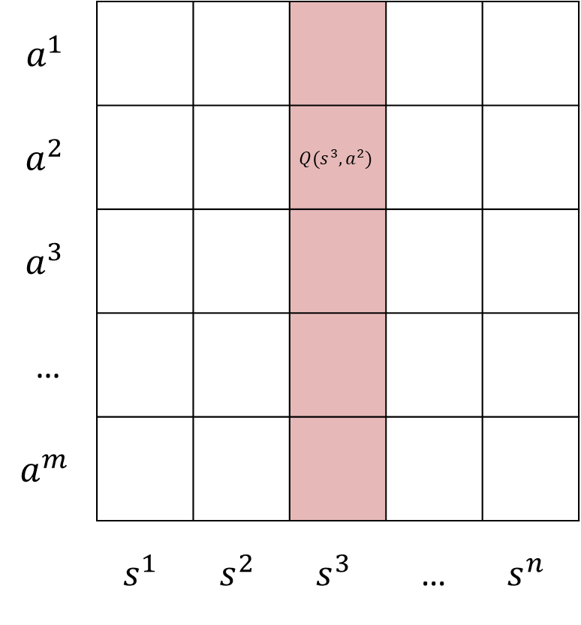
We need a finite set of actions to choose from
$$a^{1}$$
$$a^{2}$$ |  |  | $$Q(s^{3},a^{2})$$
$$a^{3}$$
…
$$a^{m}$$
 | $$s^{1}$$ | $$s^{2}$$ | $$s^{3}$$ | … | $$s^{n}$$
Q Learning:
Q function implemented as a look-up table
Input: state $s$
Output: $Q(s,a)$for each action $a∈A$

Slide 25

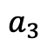
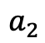
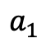
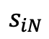
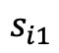
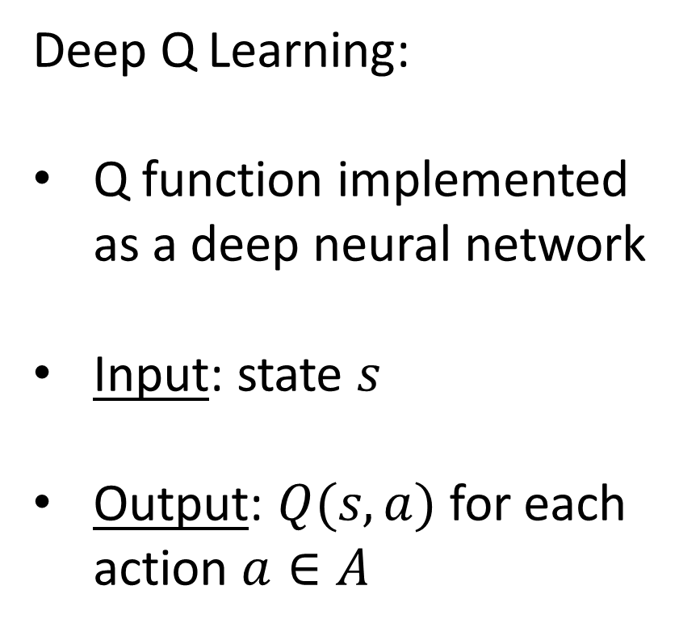
We need a finite set of actions to choose from
Deep Q Learning:
Q function implemented as a deep neural network
Input: state $s$
Output: $Q(s,a)$for each action $a∈A$
$$a_{1}$$
$$a_{2}$$
$$a_{3}$$
$$s_{i1}$$
$$s_{iN}$$
Notes:
Greater flexibility with the state, but again, the output of the neural network is like classification: it’s giving us the value of different actions

Slide 26
Tradeoff: more actions means greater flexibility, but also makes the problem more complex
Notes:
Complexity is not just computational complexity.
It also increases the size of the state-action space – the size of that lookup table – that we need to thoroughly explore

Slide 27

Actions $at$: Sepsis Management
Five IV fluid quantities:
{0, Quartile1, Q2, Q3, Q4}
×
Five vasopressor doses
{0, Quartile1, Q2, Q3, Q4}
Quartiles are defined based on the training dataset
Example action:
(Q2 fluid, 0 vasopressor)
25 possible actions

Slide 28
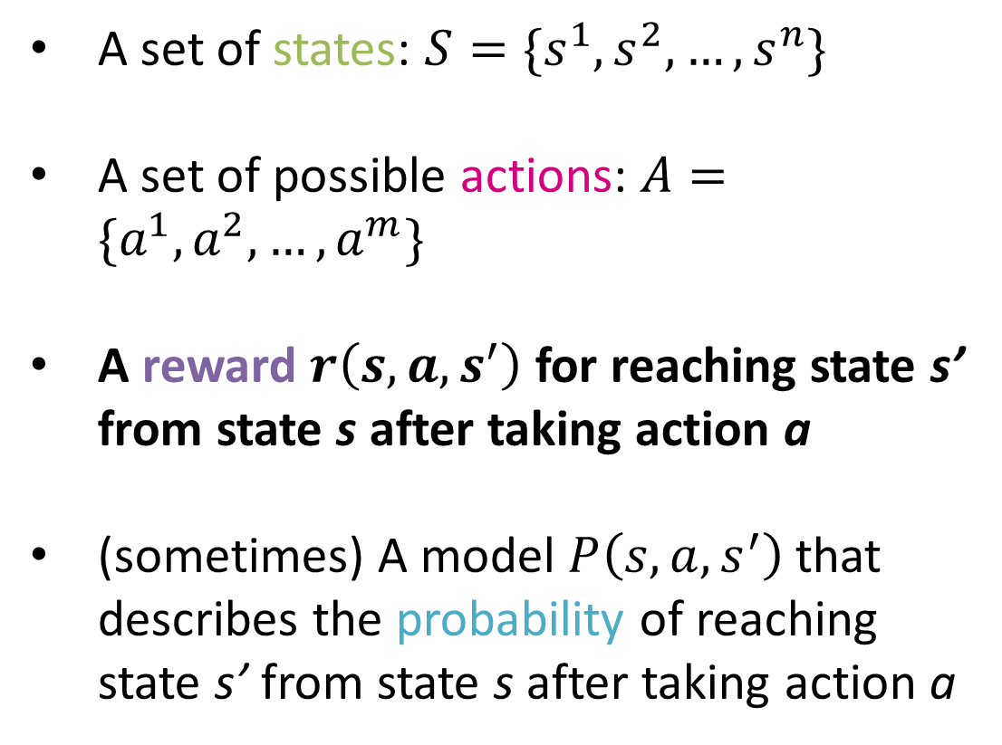
The RL Paradigm
A set of states: $S=\{s^{1},s^{2},…,s^{n}\}$
A set of possible actions: $A=\{a^{1},a^{2},…,a^{m}\}$
A reward $r\left(s,a,s^{′}\right)$ for reaching state s’ from state s after taking action a
(sometimes) A model $P\left(s,a,s^{′}\right)$that describes the probability of reaching state s’ from state s after taking action a
$… s_{t−1} a_{t−1} r_{t−1} { s}_{t} a_{t} r_{t} { s}_{t+1} …$
Notes:
Reward must be a single numeric quantity that reflects our objectives
May have to encode complicated objectives into a single number
Different treatment goals
Different goals between patients, e.g. old versus young
Health system versus patient goals

Slide 29
Clinician goals: keep the patient stable.
central venous pressure (8-12 mm Hg)
mean arterial pressure (65-90 mm Hg)
urine output (0.5 mL/kg/h)
central venous oxygen saturation (70%)
RL goals: optimize the outcome
prevent death
prevent organ damage
-> The RL algorithm chooses actions that maximize expected reward over time
“Uncertainties still exist regarding the optimal type of fluid, the optimal volume, and the best way to monitor the response to therapy.”
Gotts JE, Matthay MA. Sepsis: pathophysiology and clinical management. bmj. 2016 May 23;353(i1585).
Notes:
SOFA: sequential organ failure assessment
Traditional Approach:
central venous pressure (8-12 mm Hg)
mean arterial pressure (65-90 mm Hg)
urine output (0.5 mL/kg/h)
EGDT added:
central venous oxygen saturation (70% target in early goal directed therapy)

Slide 30
Primary objective: prevent mortality
Should this be the only goal?
We want to optimize patient outcomes, but follow-up data is not available

Slide 31
Additional Goal: Prevent Organ Dysfunction
-> SOFA Score (0-24)
Ferreira FL, Bota DP, Bross A, Mélot C, Vincent J. Serial Evaluation of the SOFA Score to Predict Outcome in Critically Ill Patients. JAMA. 2001;286(14):1754–1758.
Notes:
PaO2/FiO2 ratio
The ratio of partial pressure arterial oxygen and fraction of inspired oxygen, sometimes called the Carrico index, is a comparison between the oxygen level in the blood and the oxygen concentration that is breathed. This helps to determine the degree of any problems with how the lungs transfer oxygen to the blood.

Slide 32

Reward $rt$: Sepsis Management
Receive a large reward if the patient survives, and a large penalty if they die
Receive a penalty if the SOFA score remains greater than zero
Receive an additional penalty/reward proportional to the increase/decrease in the SOFA score
Receive an additional penalty/reward proportional to the increase/decrease in lactate

Slide 33
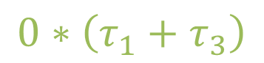
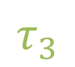
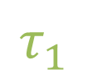
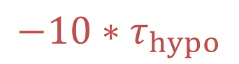
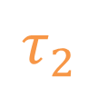

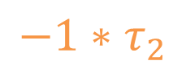
Reward $rt$: Artificial Pancreas
$$τ_{1}$$
$$τ_{2}$$
$$τ_{3}$$
hyperglycemia
$$−1∗τ_{2}$$
mmol/L
normoglycemia
$$0∗\left(τ_{1}+τ_{3}\right)$$
hypoglycemia
$$−10∗τ_{hypo}$$
https://medium.com/@justin_d_lawler/continuous-glucose-monitoring-the-first-four-weeks-7a6aa5fdb06e
Notes:
Note that we could make other choices – could penalize the degree of hypo/hyper glycemia

Slide 34



The reward quantifies our objectives
Notes:
And do these goals change between patients

Slide 35
Challenge 1: Missing Information
Sepsis Management and Artificial Pancreas

Slide 36
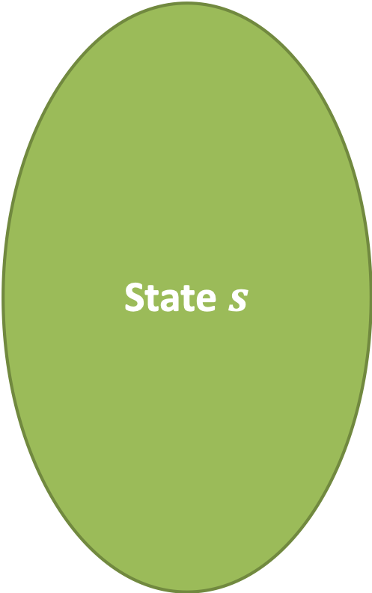
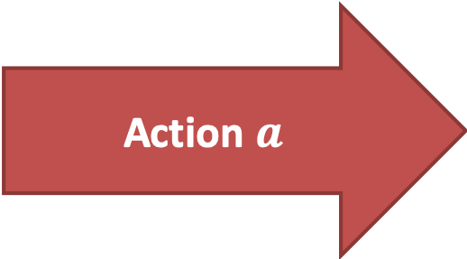
What happens when important information is missing?
State $s$
90% of the time:
good outcome
10% of the time:
bad outcome
Action $a$
Notes:
Example 1: state is slight hyperglycemia
Action is a small dose of insulin
90% -> glucose is controlled
10% -> glucose keeps rising
Example 2: state is that BP is dropping despite fluid
Action is vasopressor
90% -> stabilized
10% -> heart attack
Can be different sources of randomness. In chess, for instance, can have to do with the decisions made by the other player.
But in medicine, randomness is usually the result of missing information – information not available to us, not included in the state
Pt with severe coronary artery disease

Slide 37



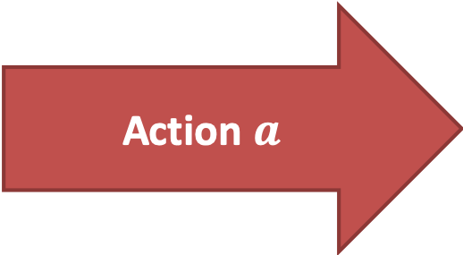
What happens when important information is missing?
State $s′$
State $s′′$
Action $a$
90% of the time:
good outcome
10% of the time:
bad outcome
Action $a$
Notes:
Example 1: state is slight hyperglycemia
Action is a small dose of insulin
90% -> glucose is controlled
10% -> glucose keeps rising
Example 2: state is that BP is dropping despite fluid
Action is vasopressor
90% -> stabilized
10% -> heart attack
Example 1: 90% patient is well. 10% patient is sick
Example 2: 10% patient has severe coronary artery disease

Slide 38
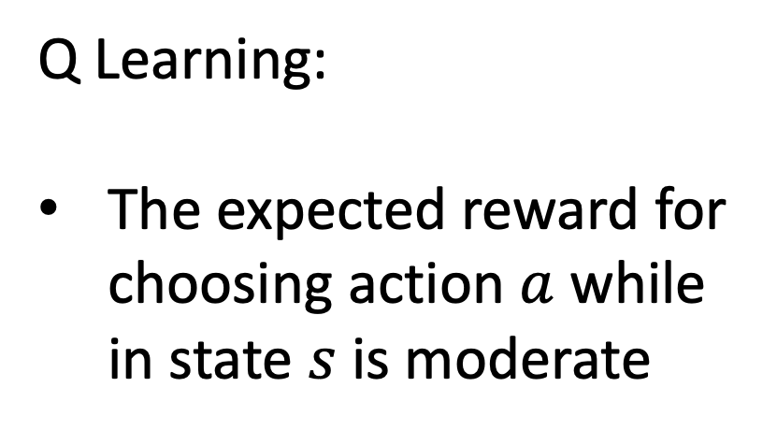
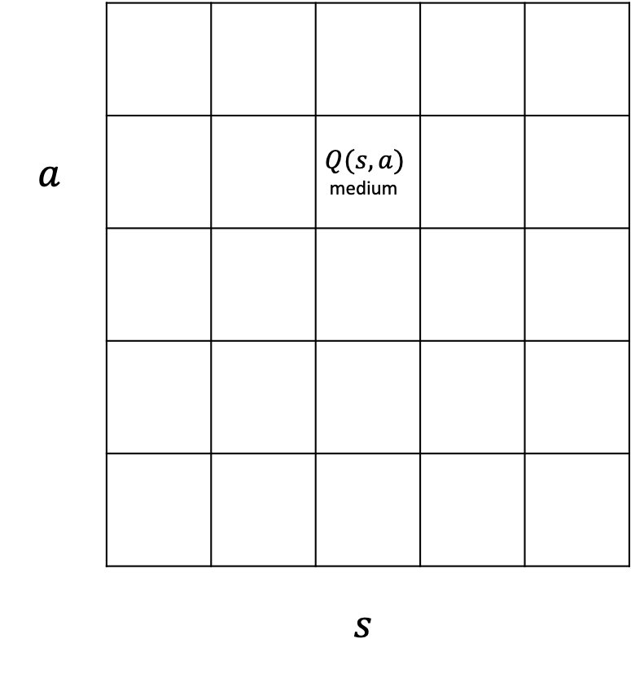
Negative impact of missing state information
$$a$$ |  |  | $$Q(s, a)$$ medium
 |  |  | $$s$$
Q Learning:
The expected reward for choosing action $a$ while in state $s$ is moderate
Notes:
Let’s suppose we’re learning as we go.
What’s the impact of this missing state information
We try something, see that it sometimes works, sometimes doesn’t
And so at the end of the day, the expected long-term reward associated with that action is moderate

Slide 39
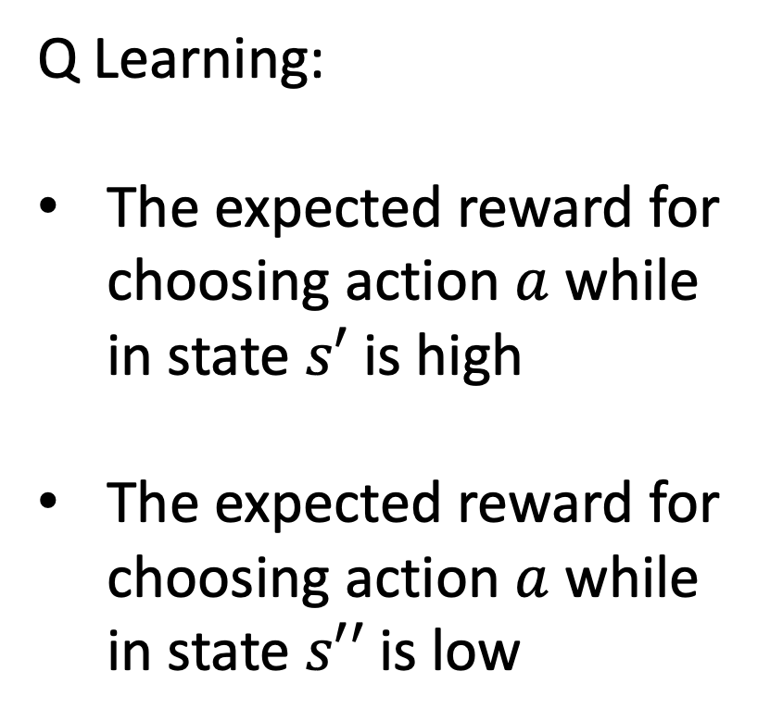
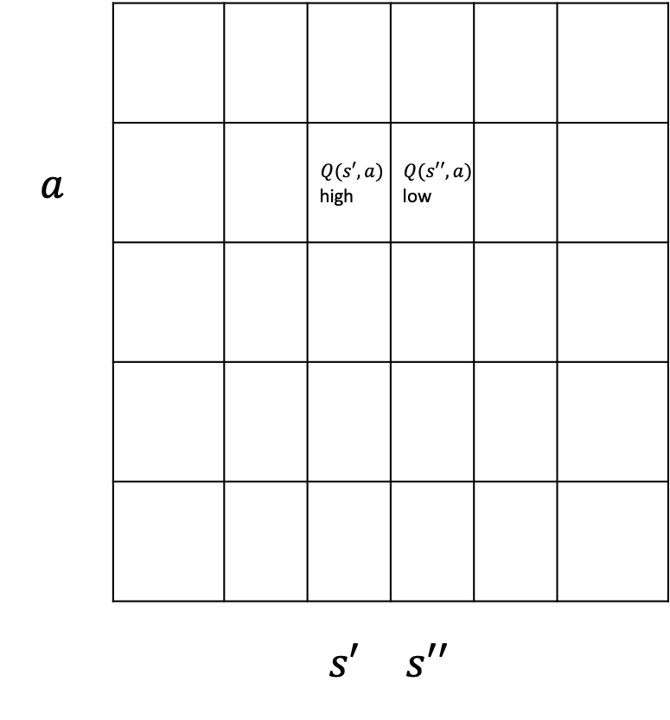
Negative impact of missing state information
$$a$$ |  |  | $$Q(s′, a)$$ high | $$Q(s′′, a)$$ low
 |  |  | $$s′$$ | $$s′′$$
Q Learning:
The expected reward for choosing action $a$ while in state $s′$ is high
The expected reward for choosing action $a$ while in state $s′′$ is low
Notes:
This prevents us from identifying that action a is sometimes very good
And sometimes very bad
And so the overall impact is that we’re not able to learn as effective a policy as we would otherwise

Slide 40
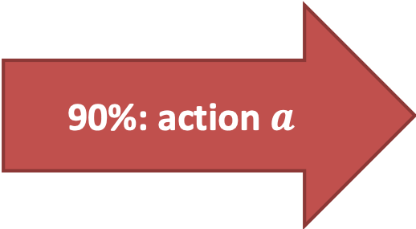
Learning from observational data: where things can REALLY go wrong
State $s$
90%: action $a$
better outcome
10%: other action
worse outcome
Notes:
Example 1: state is slight hyperglycemia
Action is a small dose of insulin
90% -> glucose is controlled
10% -> glucose keeps rising
Example 2: state is that BP is dropping despite fluid
Action is vasopressor
90% -> stabilized
10% -> heart attack
Pt with severe coronary artery disease

Slide 41
What’s really happening…
State $s′$
State $s′′$
90%: action $a$
better outcome
10%: other action
worse outcome
Notes:
Another way to say this: we have a hidden confounding variable
Example 1: state is slight hyperglycemia
Action is a small dose of insulin
90% -> glucose is controlled
10% -> glucose keeps rising
Example 2: state is that BP is dropping despite fluid
Action is vasopressor
90% -> stabilized
10% -> heart attack
Example 1: 90% patient is well. 10% patient is sick
Example 2: 10% patient has severe coronary artery disease

Slide 42
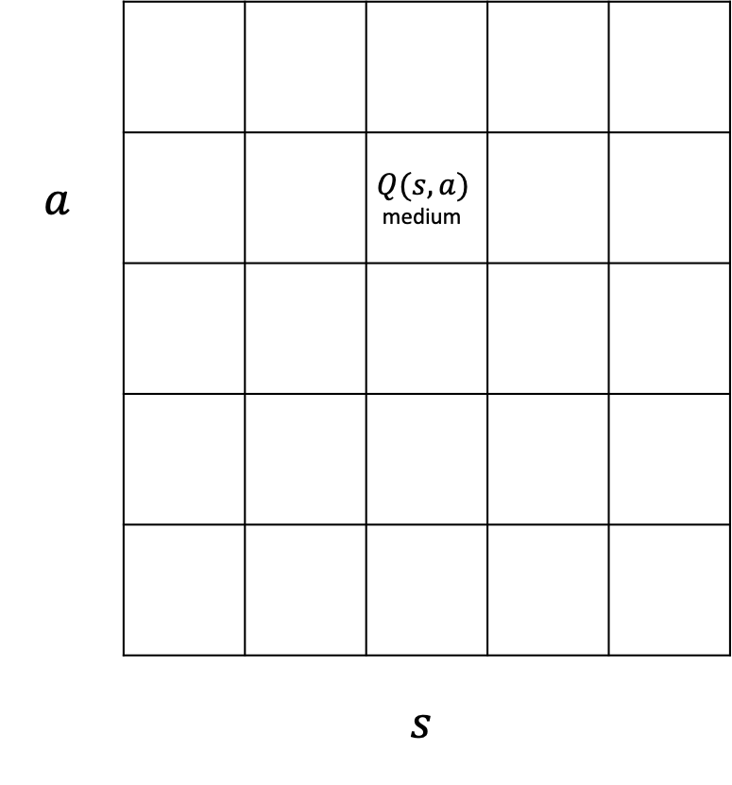
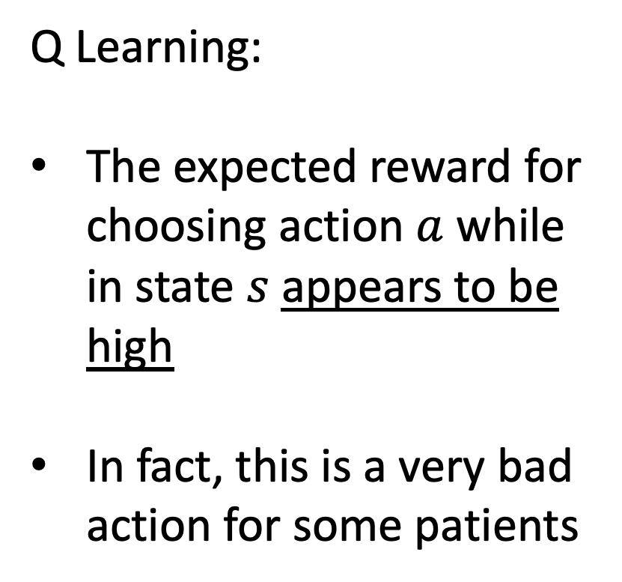
Learning from observational data: where things can REALLY go wrong
$$a$$ |  |  | $$Q(s, a)$$ medium
 |  |  | $$s$$
Q Learning:
The expected reward for choosing action $a$ while in state $s$ appears to be high
In fact, this is a very bad action for some patients

Slide 43
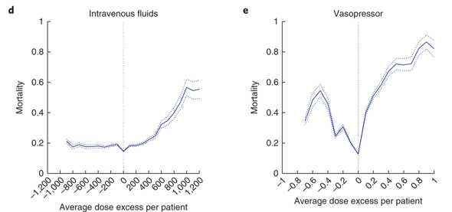
Sepsis Results: Observed Mortality
Notes:
Classification performance?
Mean Square Error?
Ideally, we compare outcomes between competing policies
In this case, the policy the algorithm is competing against is real physician decision-making
Physician policy can be directly evaluated, but the learned policy – since it was not actually followed – can only be indirectly evaluated (“off-policy evaluation”)
the results for low SOFA scores are not as informative because baseline mortality in this regime is low, and there does not appear to be significant variation in mortality with the dosage of drug given.
a, Distribution of the estimated value of the clinician and AI policies in the selected model, built by bootstrapping with 2,000 resamplings. b,c, Visualization of the clinician and AI policies. All actions were aggregated over all time steps for the five dose bins of both medications. On average, patients were administered more intravenous fluid (b) and less vasopressor (c) medications than recommended by the AI policy. Vasopressor dosage is shown in µg/kg/min of norepinephrine equivalent, and intravenous fluid dosage is shown in mL/4 h. d, The dose excess, referring to the difference between the given and suggested dose averaged over all time points per patient, for intravenous fluids (left) and vasopressor (right). The figure was generated by bootstrapping with 2,000 resamplings. The shaded area represents the s.e.m. In both plots, the smallest dose difference was associated with the best survival rates (vertical dotted line). The further away the dose received was from the suggested dose, the worse the outcome.

Slide 44
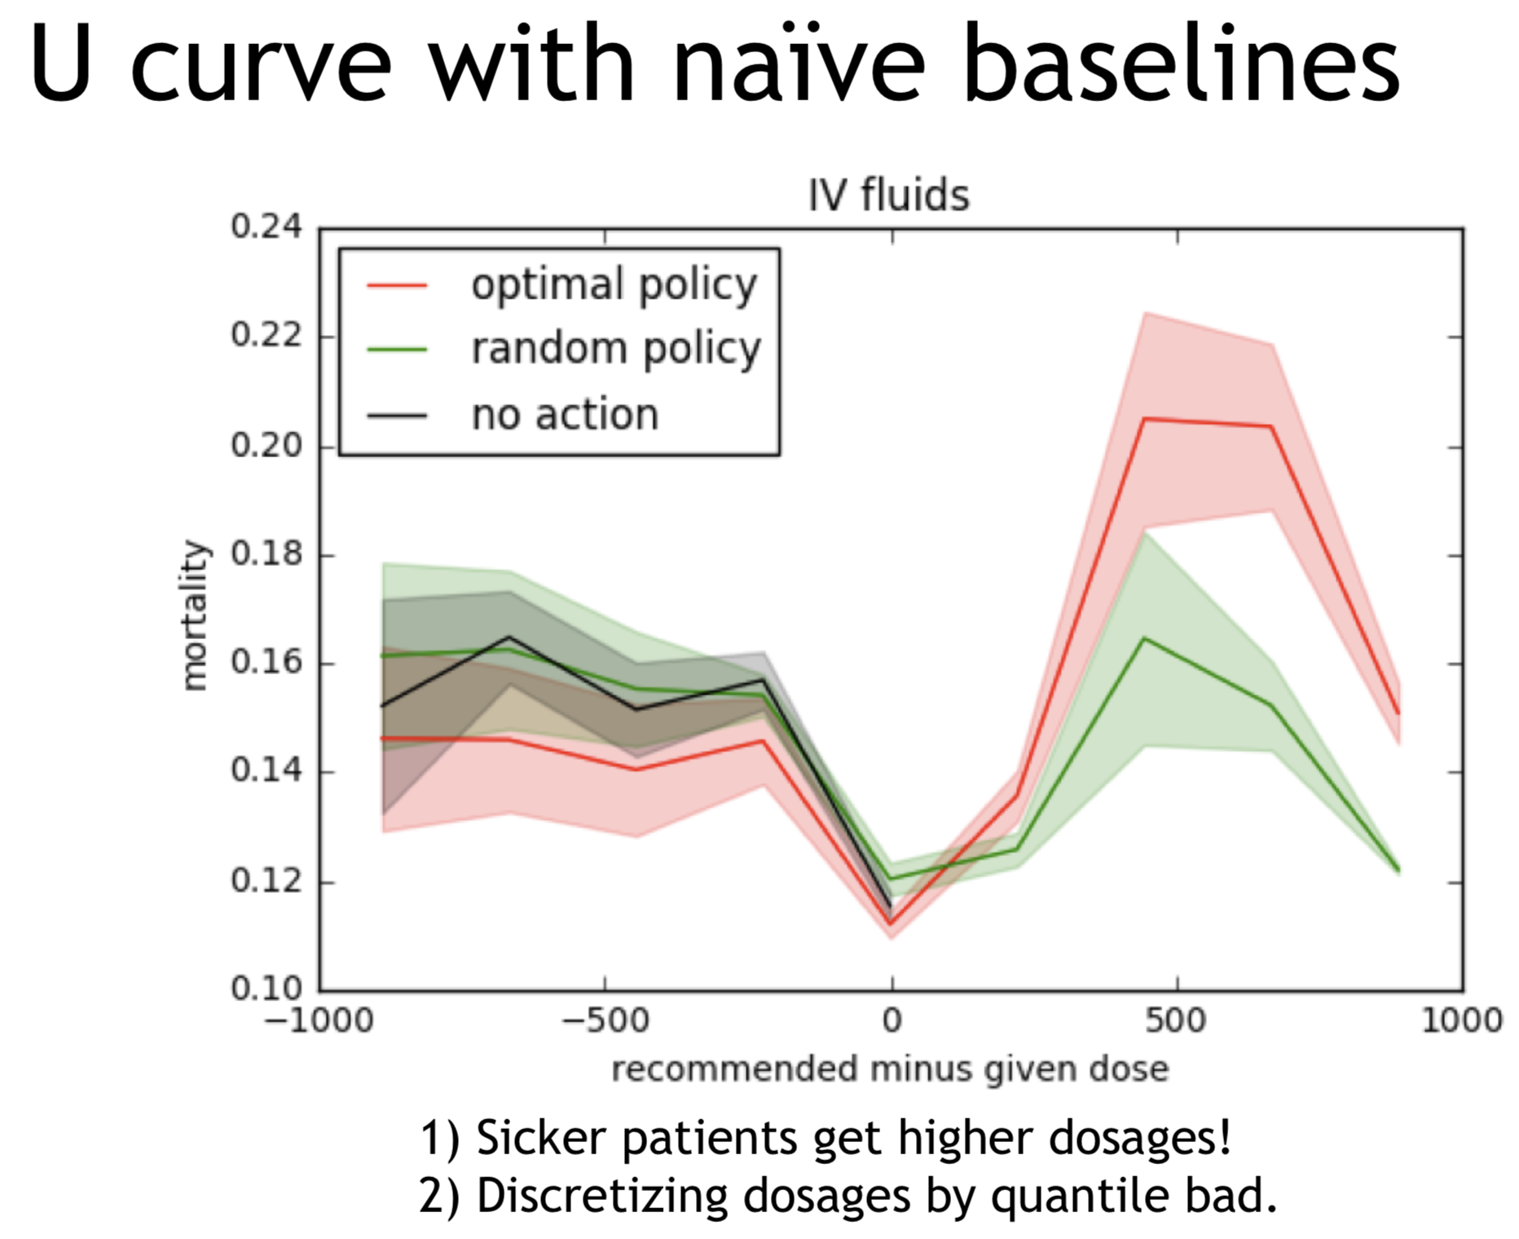
Concerns about
Off-Policy Evaluation
Slide Credit: Michael Hughes (michaelchughes.com)
Notes:
1 – off-policy evaluation: estimated value of policies
Can we compute value (expected reward) of a new target policy A, using trajectories collected under different policy B?
Strategy: weighted average of all rewards
• Upweight patients who had similar trajectories to those suggested by policy A
Not clear how well it works, hence, gold standard is to try the policy for real.
2 – method of looking at mortality based on deviation from recommendations
The idea here – when you move away from the “middle ground”, it’s indicative of something… in this case, patient may be sicker in a way not well captured by the state

Slide 45
RL: Learning through Trial and Error

Slide 46

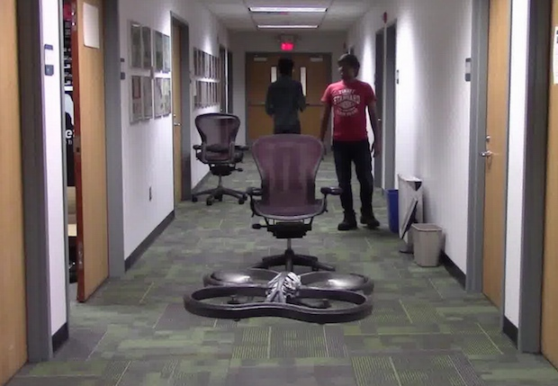
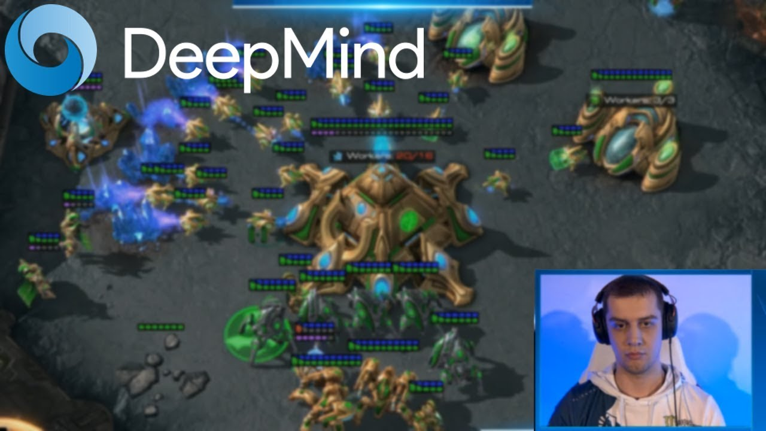
In RL, we typically learn “from scratch”:
Try things and see what works
Initially our actions are random
Drone Uses AI and 11,500 Crashes to Learn How to Fly
Crashing into objects has taught this drone to fly autonomously, by learning what not to do
By Evan Ackerman

Slide 47
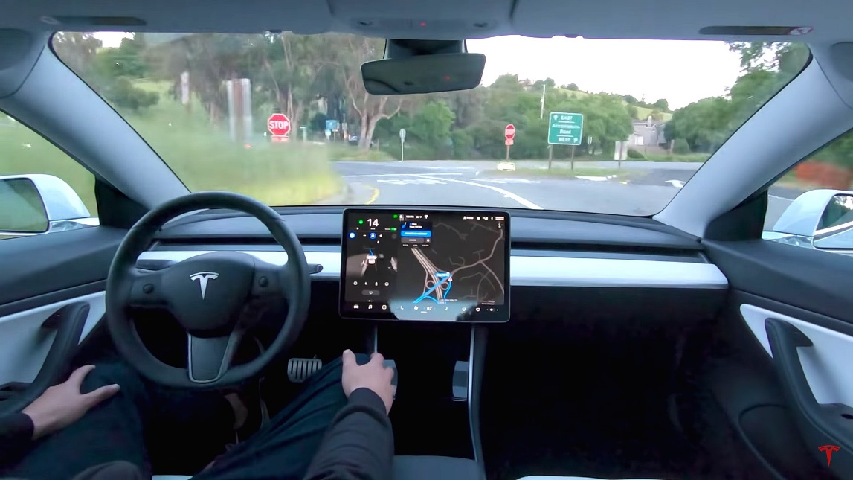
Failing 11,500 times isn’t always an option
-> What are the alternatives?

Slide 48


A1. Learn from Observational Data
The eICU Collaborative Research Database, a freely available multi-center database for critical care research. Pollard TJ, Johnson AEW, Raffa JD, Celi LA, Mark RG and Badawi O. Scientific Data (2018).
provides a large number of (state, action, reward) examples
Notes:
Have a dataset that gives us a large number of {state, action, reward} tuples. Keep updating our Q table or DNN based on these tuples until things converge
It’s as if we’re trying the actions, but the actions we’re able to try are set in advance. So the limitation here is that we can’t explore freely. We may not have any examples of particular actions from a given state, and so their value is unknown to us.
Limitation 1: can’t comprehensively explore
Limitation 2: since the agent is not actually making decisions, there may be confounding variables that are affecting actions that we don’t understand.
Explain how we do this. We simply keep iterating
Cannot control which actions are taken
Tie this back to comments from before

Slide 49
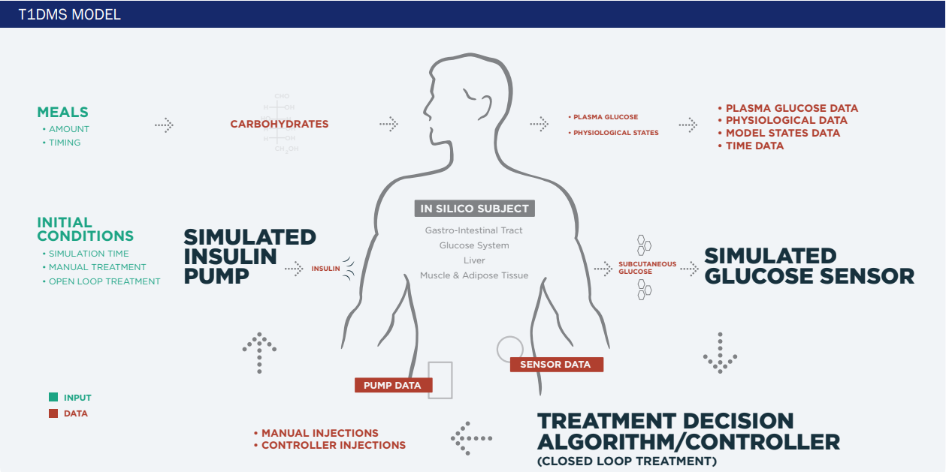
A2. Learn Policy from Simulated Environment
state
Reinforcement Learning Agent
actions
Notes:
State transitions may not match reality
Requires a good existing understanding of how actions influence the state
But, the simulator could be generated using whatever means, and may incorporate physiologic info, for example
So at UVA we have a differential equation based model, includes info about different compartments, long history of development, etc.

Slide 50

A3. Learn with Expert Oversight
physiologic state
algorithm recommendation
physician approval
Notes:
Did this at UVA
Endocrinologist in the loop
- high cost (e.g. clinician time)
- may prevent algorithm from learning a better policy

Slide 51
Open Questions for RL
How can we incorporate existing knowledge to avoid “starting from scratch”?
Should we avoid starting from scratch?
Notes:
More parallels to self-driving cars

Slide 52
Other Directions in RL for Medicine
Clinical Trials and Self-Experimentation

Slide 53
Sequential Decision-Making Problems
are Everywhere in Medicine
A reinforcement learning approach to weaning of mechanical ventilation in intensive care units.
Prasad, Niranjani, et al.
arXiv:1704.06300 (2017).
Notes:
Here we define the full RL problem – again the state is patient physiology, actions are ventilator settings, etc.
Transition – but, is there something even more fundamental?

Slide 54
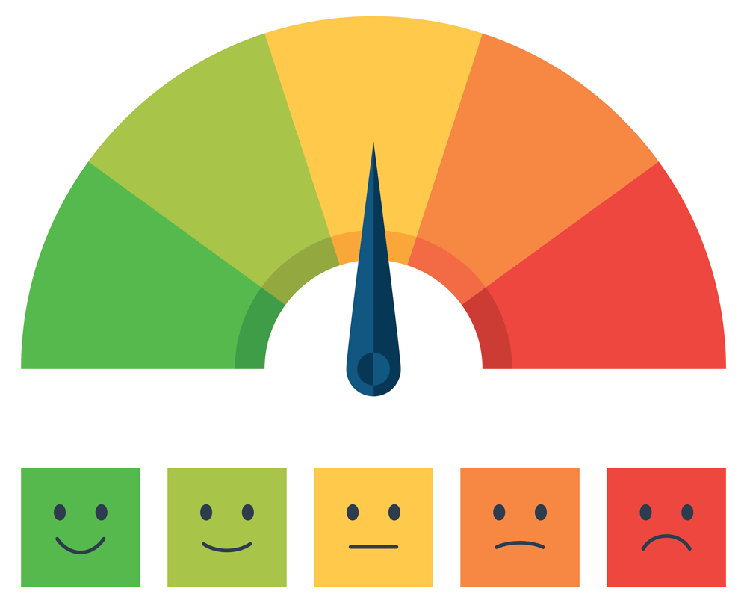

Suppose we are evaluating a new drug…
D
P
P
D
D
Notes:
Here we define the full RL problem – again the state is patient physiology, actions are ventilator settings, etc.
Transition – but, is there something even more fundamental?

Slide 55
A special case of RL
reward
actions
D
P
P
D
D
state??

Slide 56
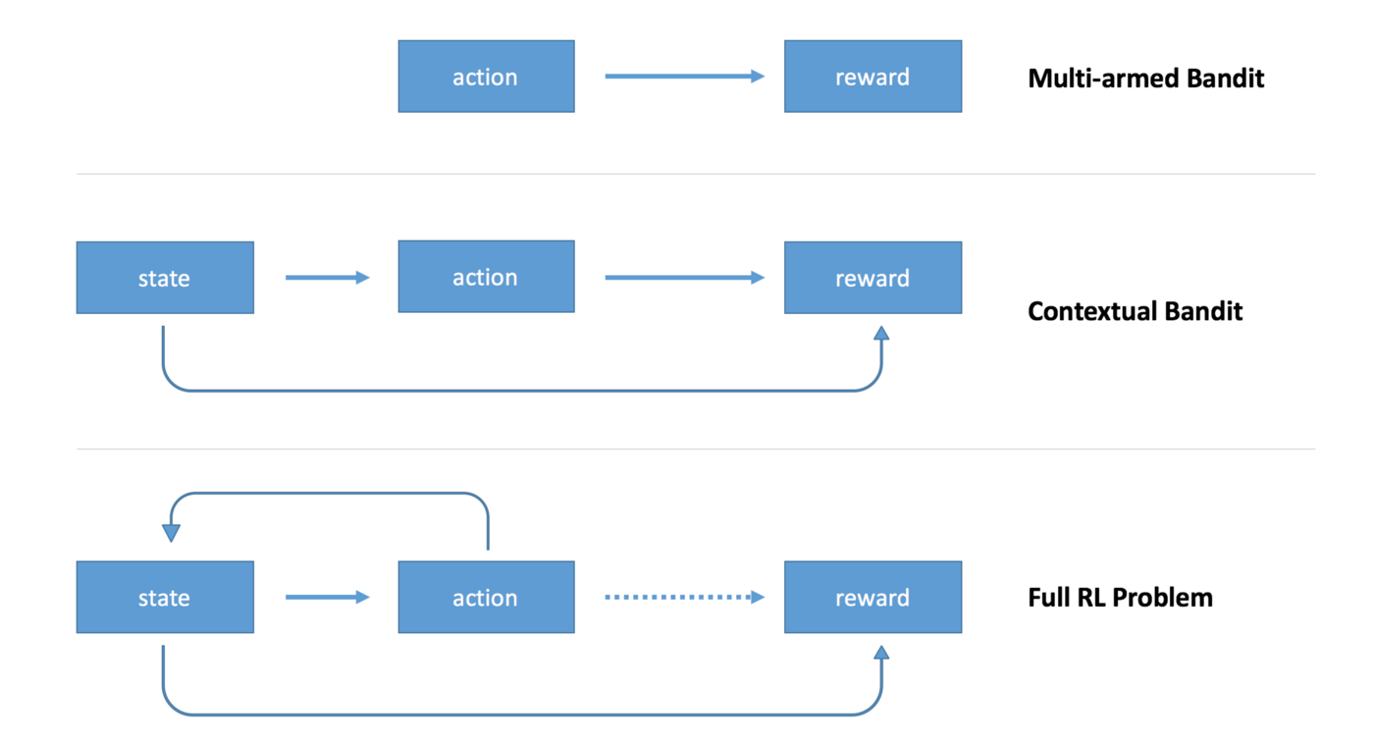
Application: Optimal Allocation of Clinical Trial Participants
“An explicit assumption is the goal to treat patients effectively, in the trial as well as out. That is controversial (…)”
(Stangl, Inoue and Irony, 2012)
Notes:
Challenges:
Modifications to meet frequentist trial design requirements (e.g. maintain higher degree of exploration to control type-I error rate)
Time delay between allocation and result
Deterministic allocation can make the trial more vulnerable to bias (e.g. participant drift, manipulation by a sponsor)

Slide 57
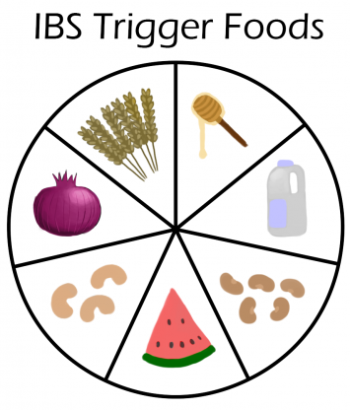
N-of-1 Trial: Identify IBS Triggers
Find foods (i.e. “actions”) that minimize IBS symptoms (i.e. “reward”)
TummyTrials: A Feasibility Study of Using Self-Experimentation to Detect Individualized Food Triggers.
Karkar R, Schroeder J, Epstein DA, et al.
SIGCHI Conference 2017;2017:6850-6863.

Slide 58
This time, we track what works for men versus women
D
P
P
D
D
Notes:
Here we define the full RL problem – again the state is patient physiology, actions are ventilator settings, etc.
Transition – but, is there something even more fundamental?

Slide 59
Personalized clinical trials can be formulated as RL
reward
actions
D
P
P
D
D
state
Notes:
Here we define the full RL problem – again the state is patient physiology, actions are ventilator settings, etc.
Transition – but, is there something even more fundamental?

Slide 60
From https://medium.com/emergent-future/
Notes:
Other example of contextual bandit – what encouragement works best for physical activity
Give one other example

